Slide 1
Cost-Aware Congestion Management Protocols for Advanced Air Mobility
Victor Qin, Hamsa Balakrishnan
ICRAT 2022

Slide 2
Introduction

Slide 3
Problem
Introduction
Notes:
AAM will have congestion
Traditional ATM is not sufficient
We resort to protocol methods

Slide 4
Problem
How do protocols prioritize different agents?
Normally assume equal WTP - not true
Auctions are a private and efficient way to determine airspace resources
Introduction

Slide 5
Contributions and Goals
We want to determine which flight should get priority when a sector is contested
Properties we like
Economic Efficiency
Ex post rationality
Fairness

Slide 6
Contributions and Goals
We make two key contributions
Chained flight auctions
Cost-aware congestion management

Slide 7
Outline

Slide 8
Formulation

Slide 9

Grid Setup
We define the grid
Equal sized sectors
Capacity 1 every sector
Only control by entry/exit
No replanning
Notes:
Set the scenario - we assume identical sectors, each with a capacity of 1
The only control method is controlling entry/exit

Slide 10

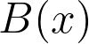
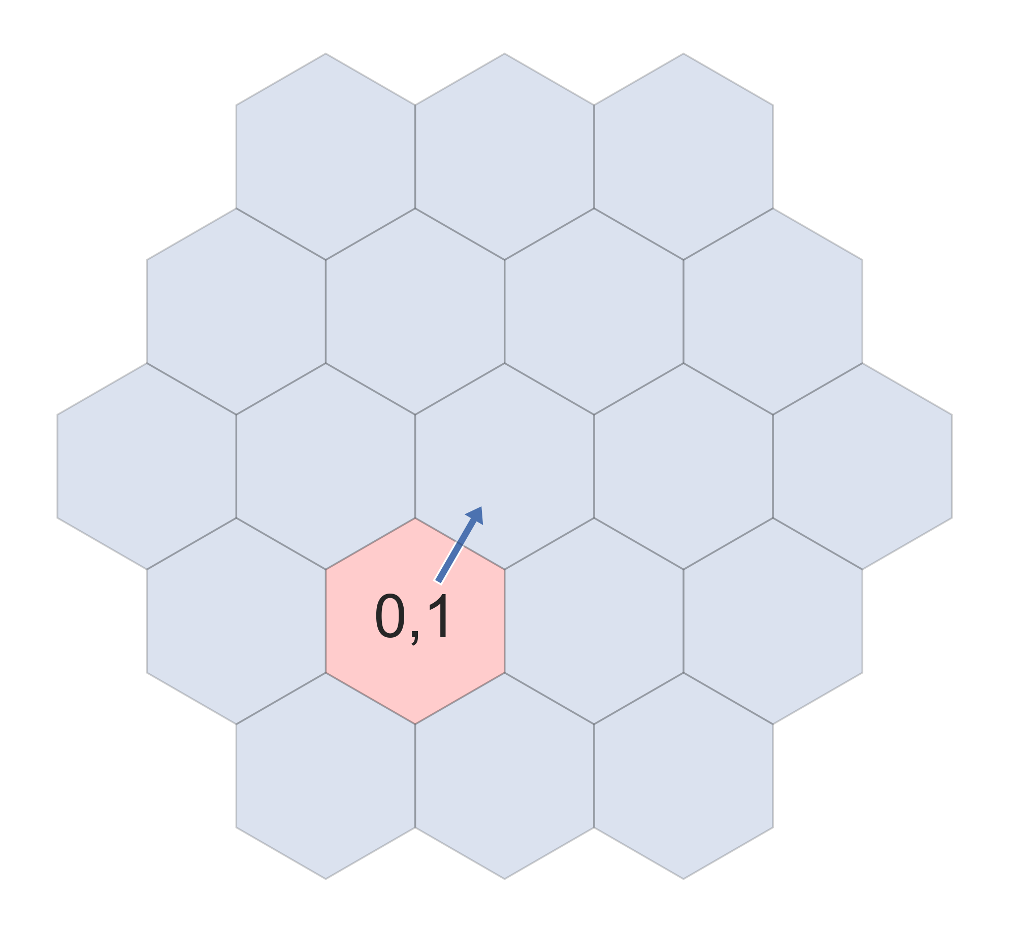
Grid Setup
Flight x
Variable cost p(x)
Next sector S(x)
Submits bid B(x)
Assume truthfulness
Marked as (x, B(x))
Arrow is S(x)

Slide 11
Existing Protocol
Work on prioritization methods in the context of the protocol in Chris’s paper
Break gridlock, then resolves by backpressure

Slide 12
Current Prioritization Methods
Notes:
Random, Round-robin, Delay, Backpressure
Focus specifically on Backpressure - need to get this concept across quickly

Slide 13
Methods

Slide 14
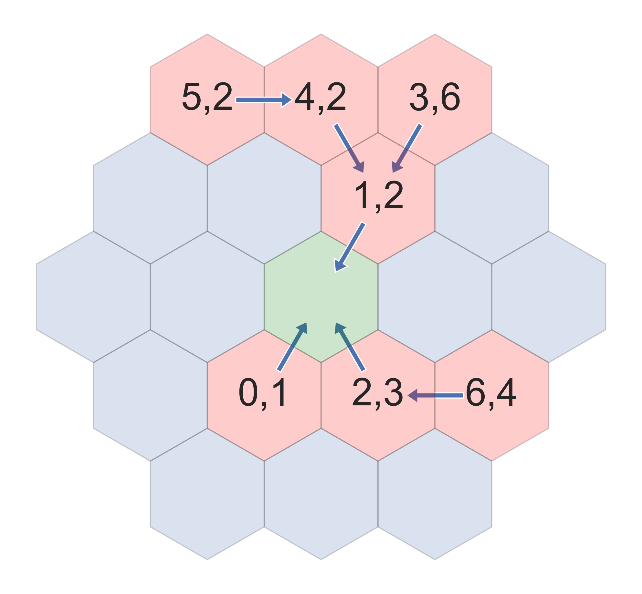


A Scenario
Consider this scenario

Slide 16
Cost Aware Prioritization Methods

Slide 17





Vickrey-Clarke-Groves (Second Price Auctions)
– Efficiency
– Truthfulness
– Budget-Balance
5
2
3
4
Notes:
Second Price Auction
Icons representing each - then show the bids and bid prices?

Slide 18
Vickrey-Clarke-Groves (Second Price Auctions)
4
Notes:
Second Price Auction
Icons representing each - then show the bids and bid prices?

Slide 19

Second Price Prioritization
5
5
5
5
Notes:
Taking the VCG mechanism now
Lay out how this works on the Toy example

Slide 20
Second Price Prioritization
Notes:
Show how it works on the illustrated setup?

Slide 21
Second Price Prioritization
Notes:
A slide with the math?

Slide 22
Chained Flights
5
5
5
5
Notes:
However because we didn’t move a flight last time, we caused more delay
Bring back the idea from backpressure - decisions at the front affect everyone in the “chain”
Solution: instead of considering each agent at the front as bidder, consider every chain as a bidder
Resolve the most pressing chain

Slide 23
Chained Flights
5
5
5
5
Notes:
Need to consider subconflicts as well, how do we deal between the two chains there

Slide 24
Second Backpressure Prioritization
5
5
5
5
Notes:
Solution: instead of considering each agent at the front as bidder, consider every chain as a bidder
Resolve the most pressing chain

Slide 25
Second Backpressure Prioritization
5
5
5
5
Notes:
New problem: who pays for the combined bid?
Assume proportional division - bids are truthful, so the more benefit you got the more you should pay

Slide 26
Second Backpressure Prioritization
Notes:
Slide demonstrating the mechanism visually

Slide 27
Results

Slide 28
Methodology
Major considerations: Efficiency and Fairness
Tested on 4 scenarios
Costs randomly assigned
2x2 of the scenarios
Notes:
We evaluated
Random, RoundRobin, Backpressure
Secondprice, Secondback
Cost is allocated randomly (uniform?)
We care how they perform in efficiency and fairness, both for all flights and among operators of flights

Slide 29
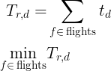
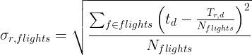
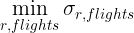
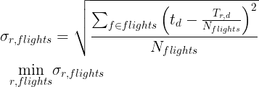
Methodology
Major considerations: Efficiency and Fairness
With respect to delay:
Efficiency: minimize delay
Fairness: minimize standard deviation
Notes:
Efficiency is the minimum amount of delay

Slide 30
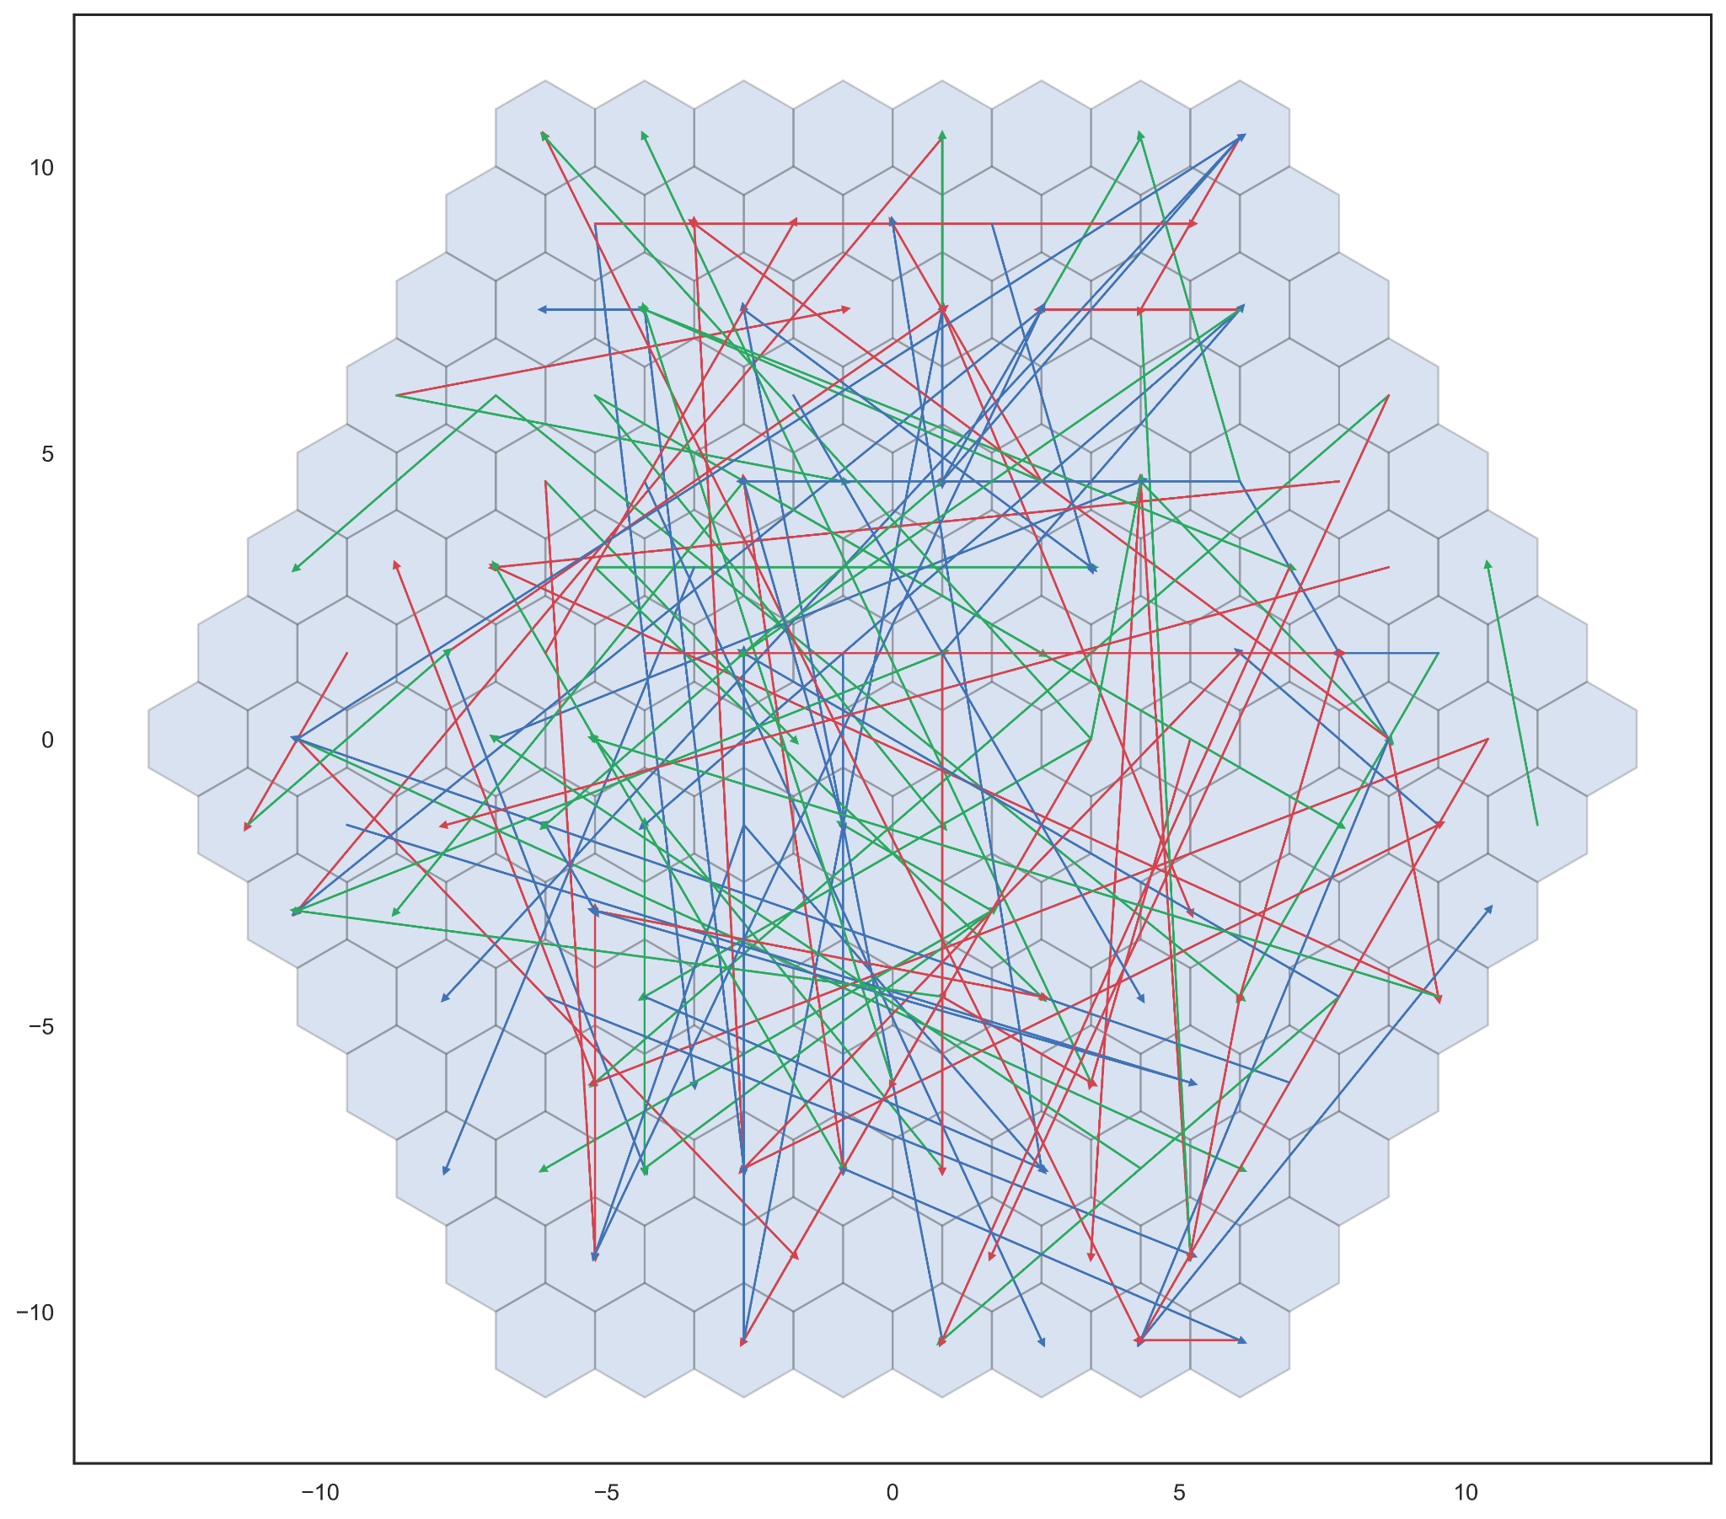
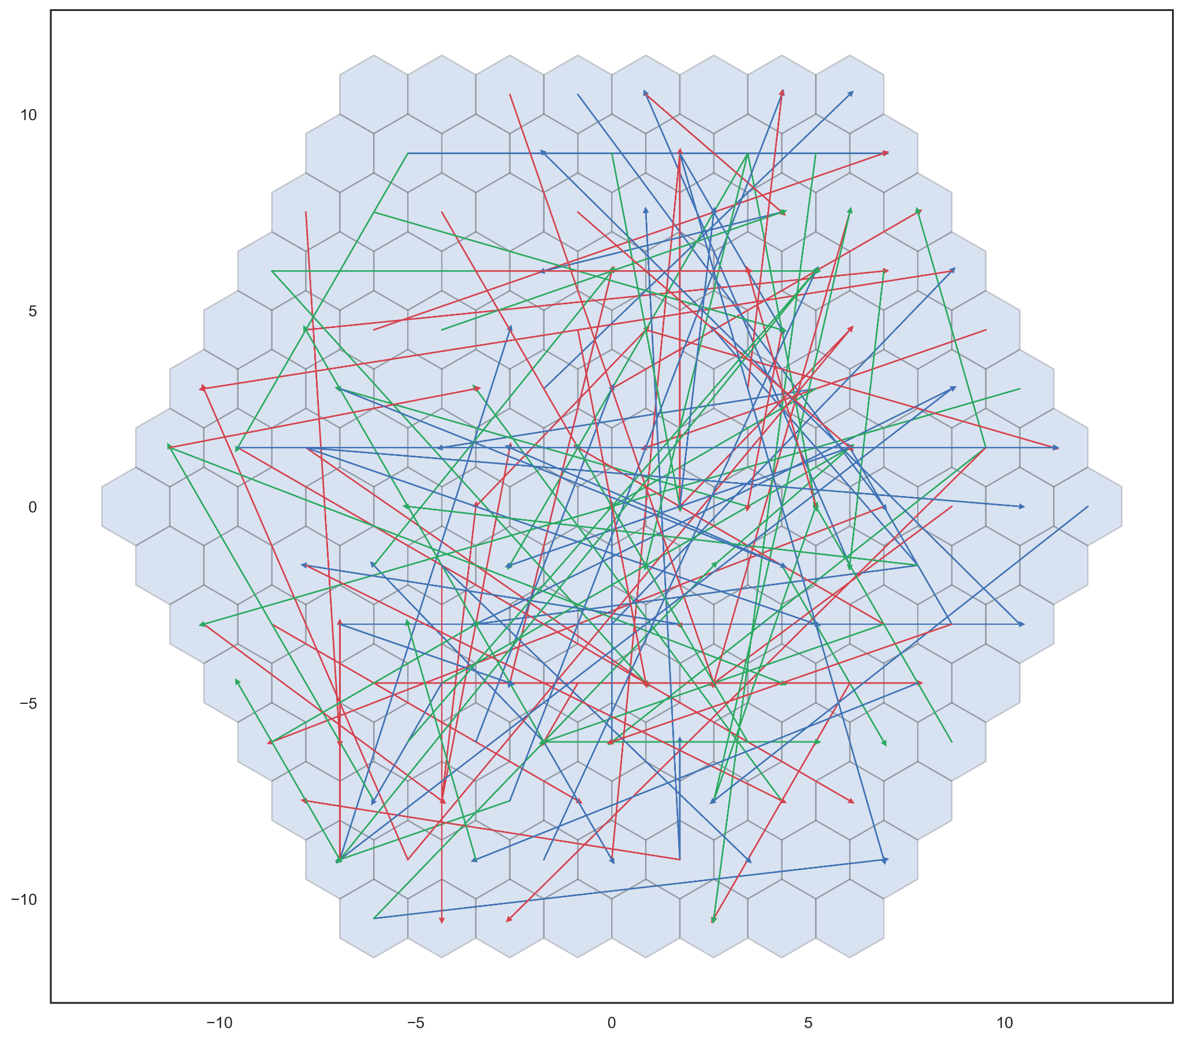
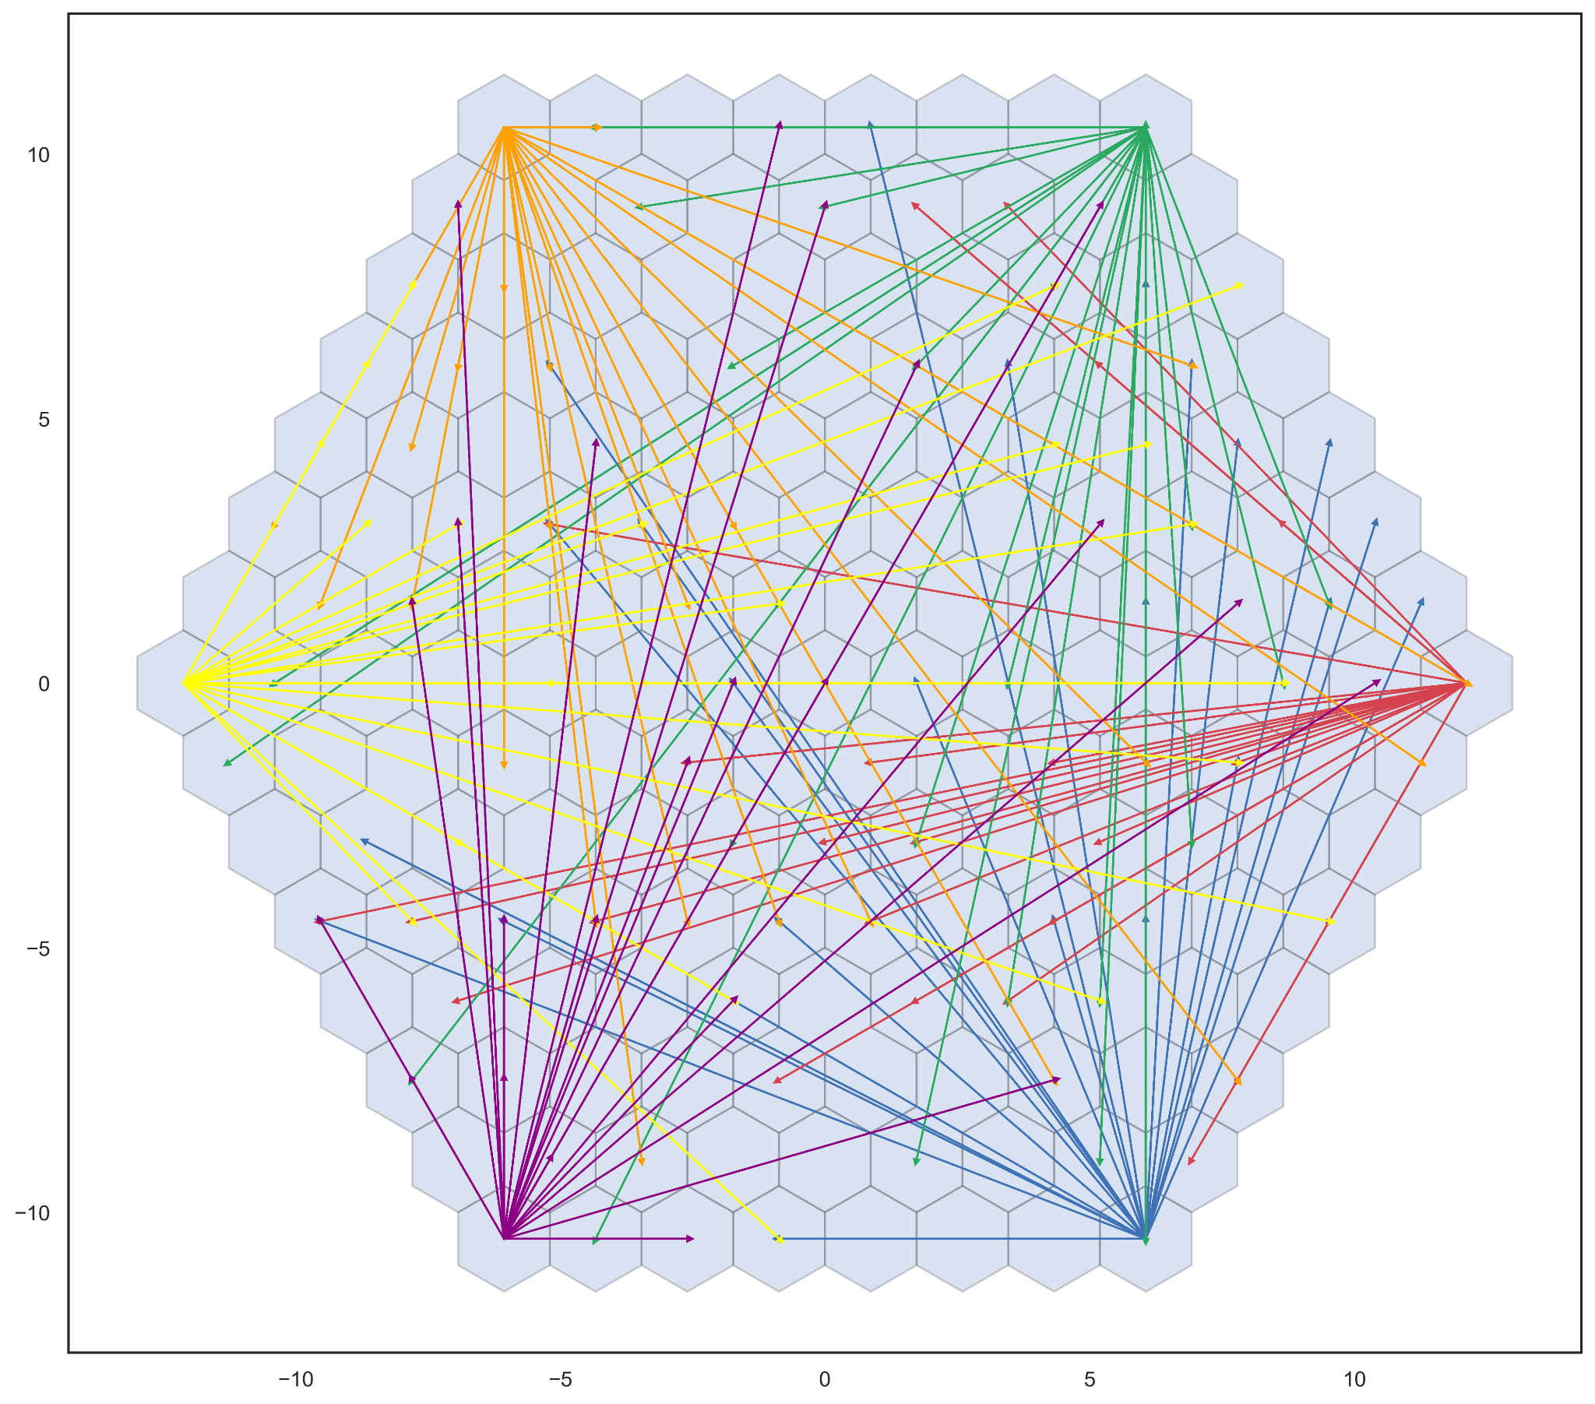
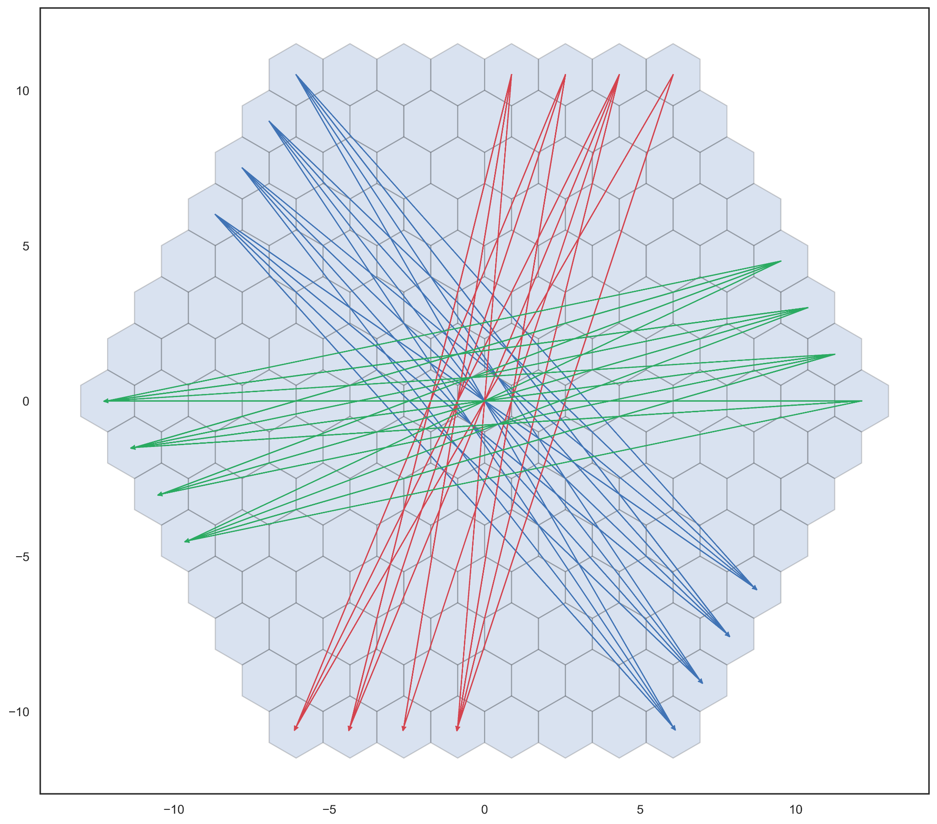
Scenarios
Random
bimodal
Crossing
Hub and Spoke

Slide 31
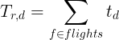
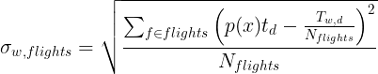
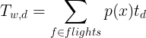
System Metrics
Efficiency
Fairness
Weighted Efficiency
Weighted Fairness

Slide 32
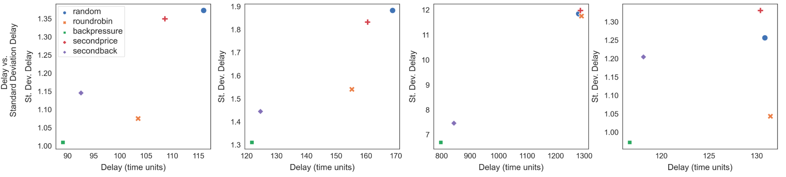
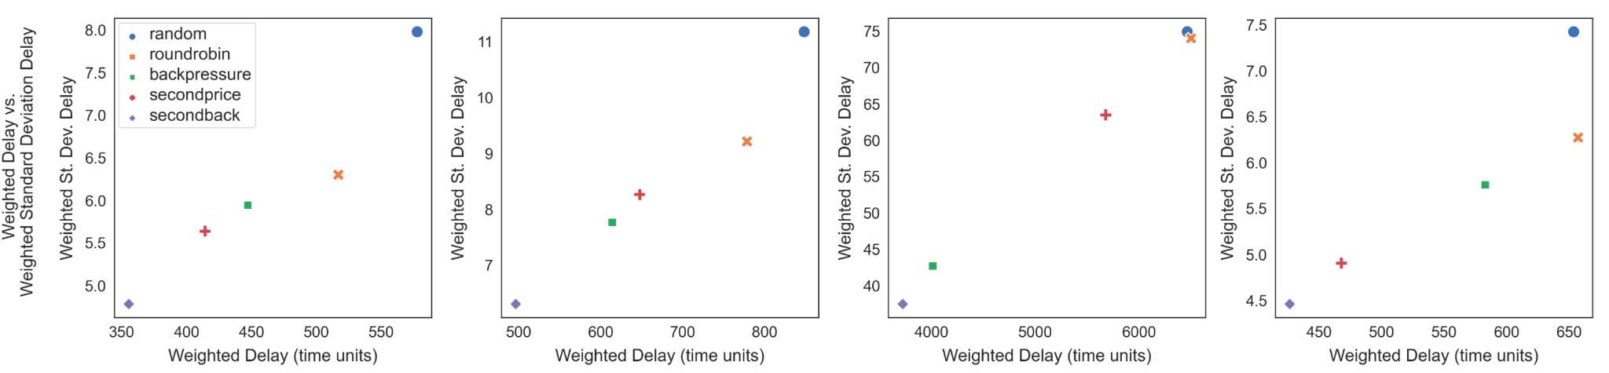
System Results
Do the math for percent change?
Random
Bimodal
Crossing
Hub and Spoke
Swap the order? Weighted is technically more in line with our proposal here
Raw Metrics
Weighted Metrics
Notes:
The lower right is better - minimize delay = max efficiency, min standev = max fairness
Backpressure methods are pretty good - Secondback is competitive on delay, less fair
Weighted metrics - Secondback clearly outperforms in all cases, Secondprice follows sort of

Slide 33
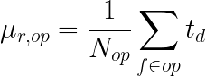
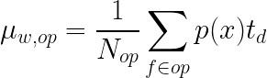
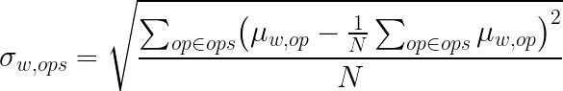

Operator Metrics
Operators have multiple flights - ensure operator fairness
Notes:
Consider grouping flights into operators - want to make sure operators are fairly treated
Assume random grouping of flights into operator groups

Slide 34
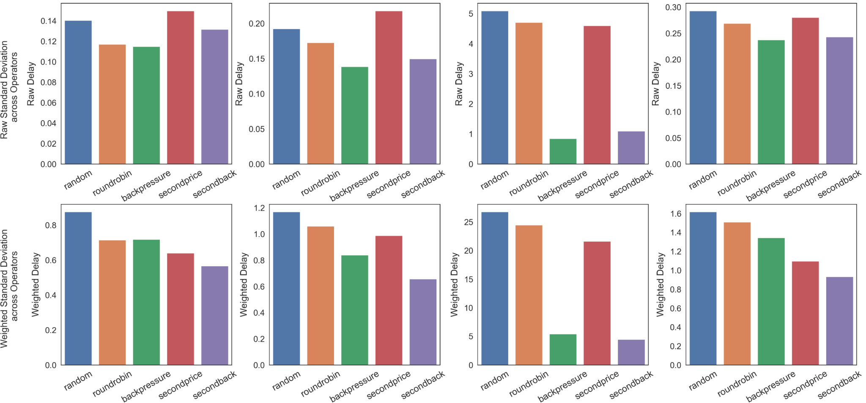
Operator Results

Slide 35
Conclusion

Slide 36
Thank You!

